Slide 1

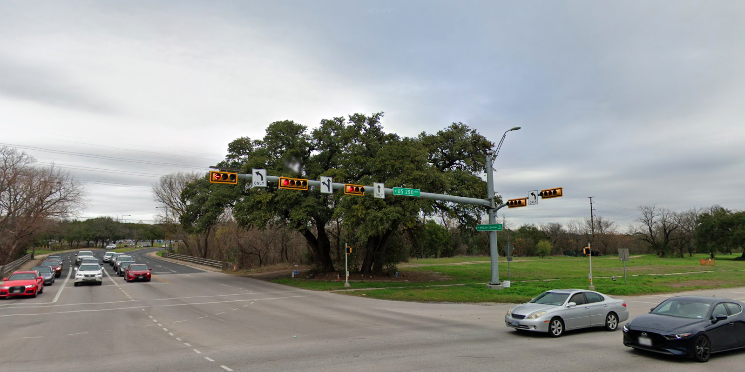
Austin Transportation Department Signs Work Orders
Created By: Susanne Gov Created Date: 2020-05-21 Location Name: US 290 HWY / WILLIAM CANNON DR Intersection ID: 5144899 Cardinal Direction: N
Sign Type | Install/Remove
Street Name Sign | Install
Left Turn Arrow Only | Install
Left Straight Arrow | Install
Straight Arrow Only | Install

Slide 2
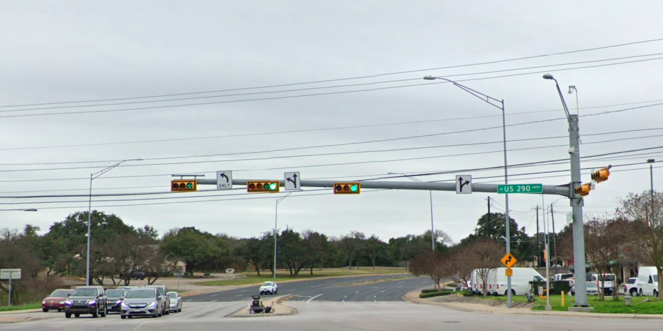
Austin Transportation Department Signs Work Orders
Created By: Susanne Gov Created Date: 2020-05-21 Location Name: US 290 HWY / WILLIAM CANNON DR Intersection ID: 5144899 Cardinal Direction: S
Sign Type | Install/Remove
Left Turn Arrow Only | Install
Street Name Sign | Install
Left Straight Arrow | Install
Straight Right Arrow | Install

Slide 3
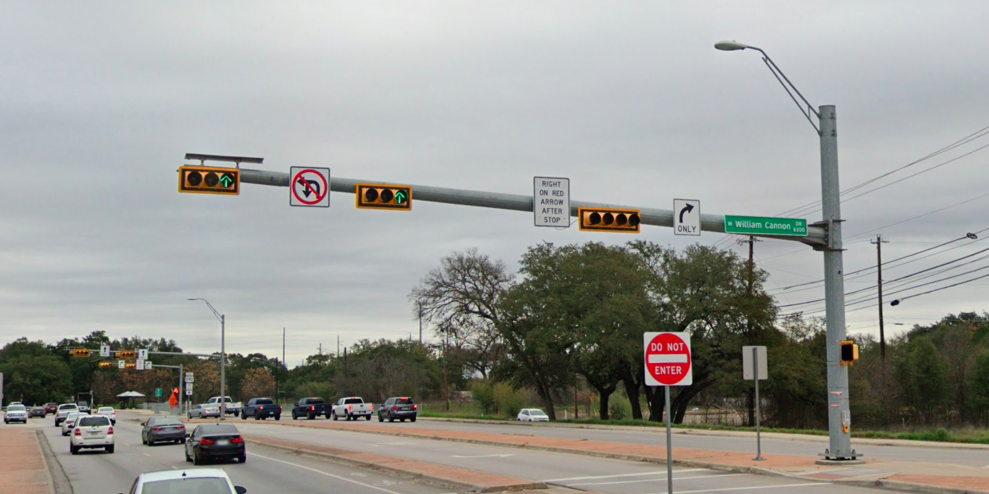
Austin Transportation Department Signs Work Orders
Created By: Susanne Gov Created Date: 2020-05-21 Location Name: US 290 HWY / WILLIAM CANNON DR Intersection ID: 5144899 Cardinal Direction: E
Sign Type | Install/Remove
Right Arrow Only | Install
Street Name Sign | Install
No Left U Turn Arrow | Install
Right On Red Arrow After Stop | Install

Slide 4
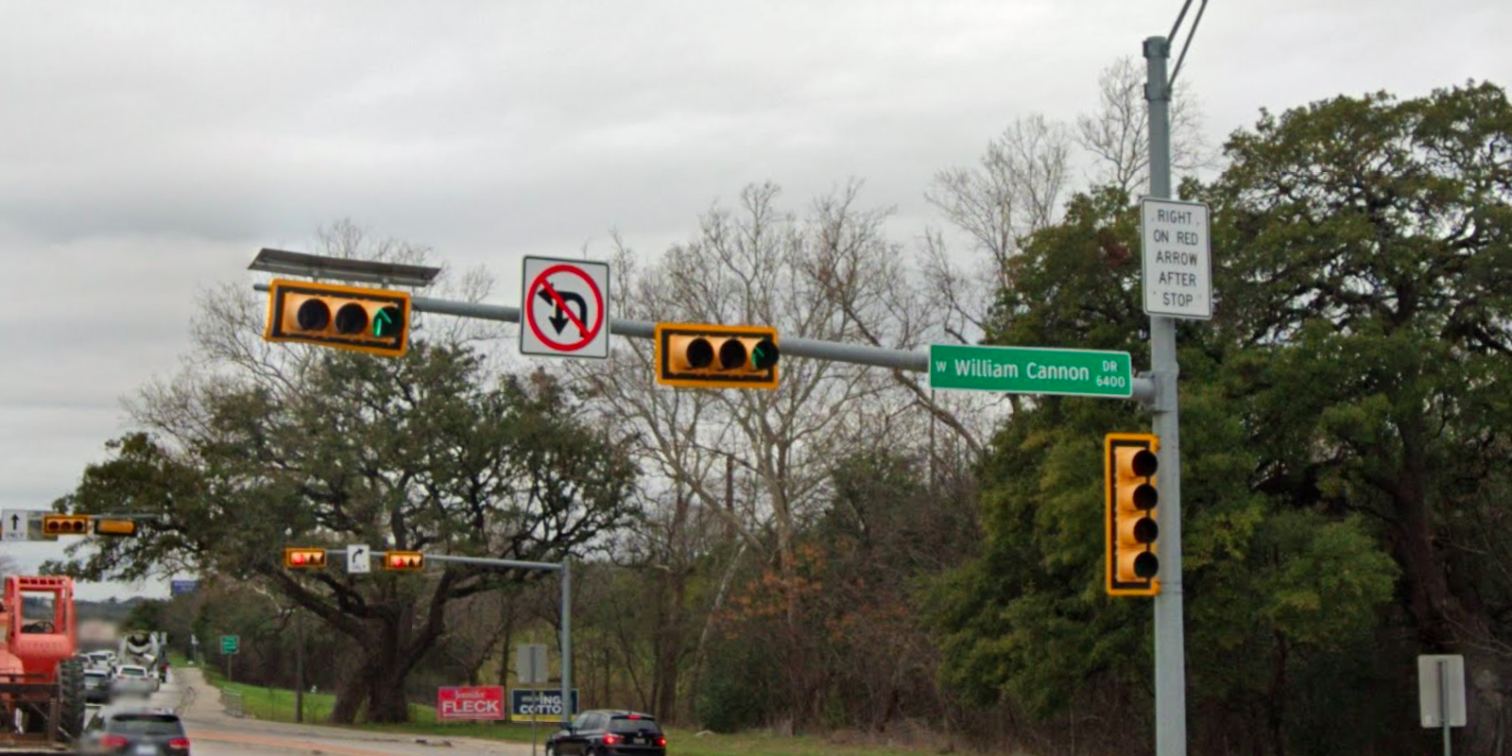
Austin Transportation Department Signs Work Orders
Created By: Susanne Gov Created Date: 2020-05-21 Location Name: US 290 HWY / WILLIAM CANNON DR Intersection ID: 5144899 Cardinal Direction: W
Sign Type | Install/Remove
Right On Red Arrow After Stop | Install
Street Name Sign | Install
No Left U Turn Arrow | Install

